Slide 1
Prometheus and Grafana
Monitoring and Visualization

Slide 2
Introduction
• Prometheus: Open-source monitoring & alerting toolkit.
• Grafana: Open-source visualization tool.
• Used for monitoring applications, infrastructure, & cloud.

Slide 3
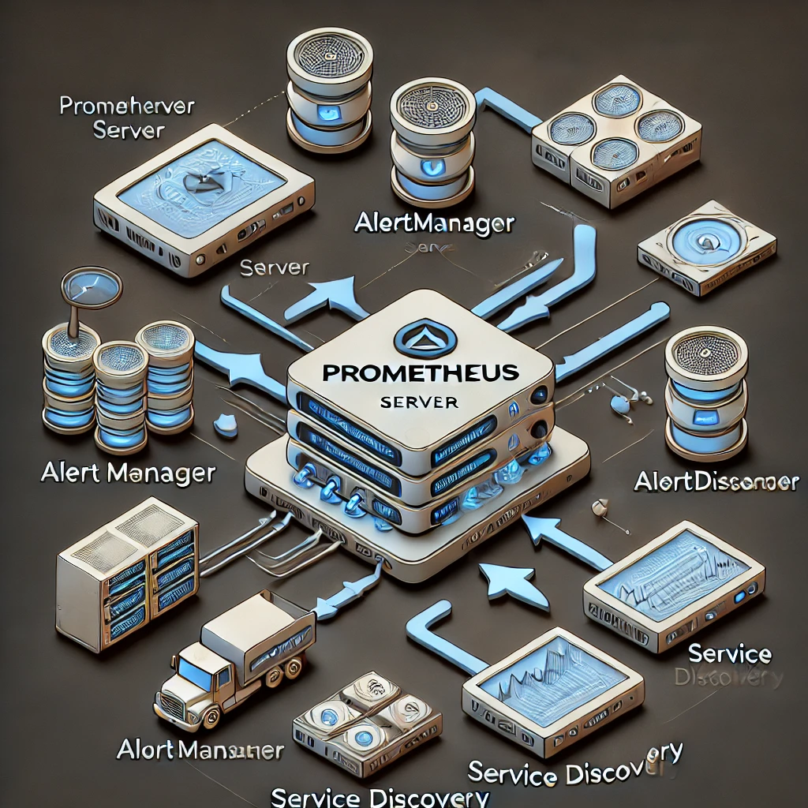
Prometheus Architecture

Slide 4
Setting Up Prometheus
1. Download and install Prometheus.
2. Configure prometheus.yml.
3. Run Prometheus & access UI at localhost:9090.
4. Add exporters for more data sources.

Slide 5
Grafana Overview & Features
• Connects to multiple data sources.
• Customizable dashboards.
• Supports alerting & notifications.
• User authentication & team collaboration.

Slide 6

Grafana Dashboard Example

Slide 7
Connecting Prometheus to Grafana
1. Open Grafana and log in.
2. Add Prometheus as a data source.
3. Configure Prometheus URL (http://localhost:9090).
4. Save and test the connection.

Slide 8
Creating Dashboards in Grafana
• Add a new panel.
• Select Prometheus as data source.
• Use PromQL to query data.
• Customize visualization (graphs, tables, heatmaps, etc.).

Slide 9
Use Cases & Applications
• Infrastructure monitoring (CPU, RAM, Disk usage).
• Kubernetes monitoring.
• Application performance monitoring.
• Business analytics.

